Slide 1

Computer Organization & Assembly language(CS-215T)
Lecture by:
Mr. Shakir Karim
Assistant Professor
DoCS&IT, SSUET
Batch 2022F

Slide 2
Week 7
Multiplication using Booth Algorithm;
Division concept
Computer Science & Information Technology Department
Sir Syed University of Engg. & Tech.
Lecture by: Mr. Shakir Karim

Slide 3
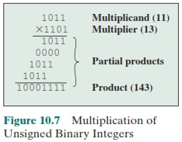
Multiplication
Computer Science & Information Technology Department
Sir Syed University of Engg. & Tech.
Lecture by: Mr. Shakir Karim

Slide 4
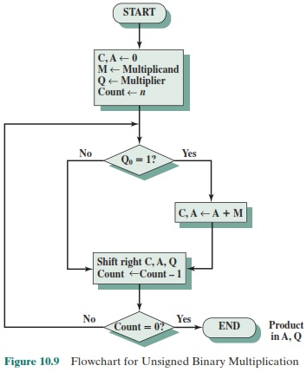
Multiplication-The Flow Chart
Computer Science & Information Technology Department
Sir Syed University of Engg. & Tech.
Lecture by: Mr. Shakir Karim

Slide 5
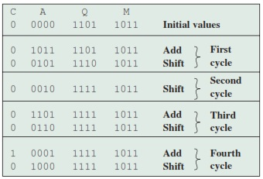
Multiplication-General Algorithm
Computer Science & Information Technology Department
Sir Syed University of Engg. & Tech.
Lecture by: Mr. Shakir Karim

Slide 6
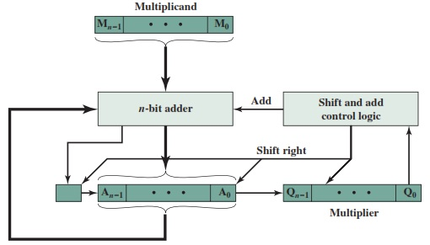
Multiplication-The Block Diagram
Computer Science & Information Technology Department
Sir Syed University of Engg. & Tech.
Lecture by: Mr. Shakir Karim

Slide 7
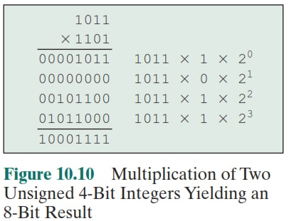
Multiplication – Another Example
What if both numbers are negative?
Answer is incorrect
Computer Science & Information Technology Department
Sir Syed University of Engg. & Tech.
Lecture by: Mr. Shakir Karim

Slide 8
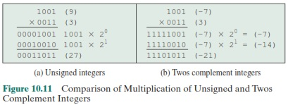
Multiplication – What To Do?
So, this correction is implemented by
Booth’s Algorithm
Computer Science & Information Technology Department
Sir Syed University of Engg. & Tech.
Lecture by: Mr. Shakir Karim

Slide 9
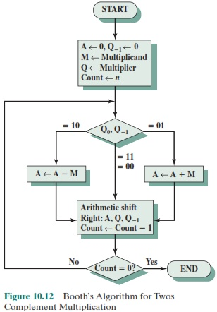
Multiplication-Booth Flow Chart
Computer Science & Information Technology Department
Sir Syed University of Engg. & Tech.
Lecture by: Mr. Shakir Karim

Slide 10
Arithmetic Shift Right
Assembly Instruction SAR is available
MSB is copied while shifting
For Example:
Consider 10001100 to be shifted arithmetic right
Then
1 0 0 0 1 1 0 0
1 1 0 0 0 1 1 0
Computer Science & Information Technology Department
Sir Syed University of Engg. & Tech.
Lecture by: Mr. Shakir Karim

Slide 11
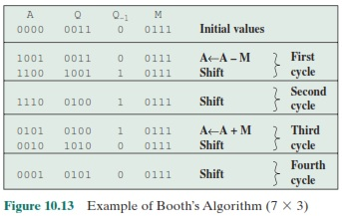
Multiplication-Booth Algorithm
Computer Science & Information Technology Department
Sir Syed University of Engg. & Tech.
Lecture by: Mr. Shakir Karim

Slide 12
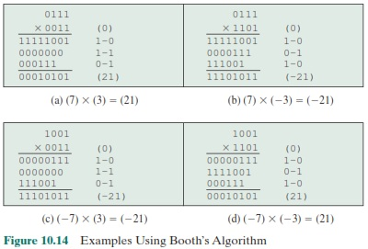
Multiplication-Booth Algorithm
Computer Science & Information Technology Department
Sir Syed University of Engg. & Tech.
Lecture by: Mr. Shakir Karim

Slide 13
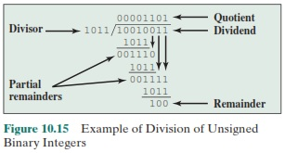
Division
Computer Science & Information Technology Department
Sir Syed University of Engg. & Tech.
Lecture by: Mr. Shakir Karim

Slide 14
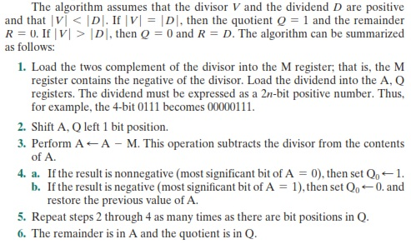
Division Algorithm
Computer Science & Information Technology Department
Sir Syed University of Engg. & Tech.
Lecture by: Mr. Shakir Karim

Slide 15
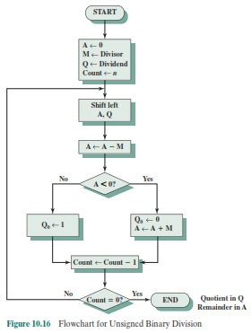
Division Flow Chart
Computer Science & Information Technology Department
Sir Syed University of Engg. & Tech.
Lecture by: Mr. Shakir Karim

Slide 16


Signed Division
Computer Science & Information Technology Department
Sir Syed University of Engg. & Tech.
Lecture by: Mr. Shakir Karim

Slide 17
Signed Division (Conclusion)
A simple way to do twos complement division is
to convert the operands into unsigned values
and at the end account for the signs
by complementation where needed
Computer Science & Information Technology Department
Sir Syed University of Engg. & Tech.
Lecture by: Mr. Shakir Karim

